Slide 1
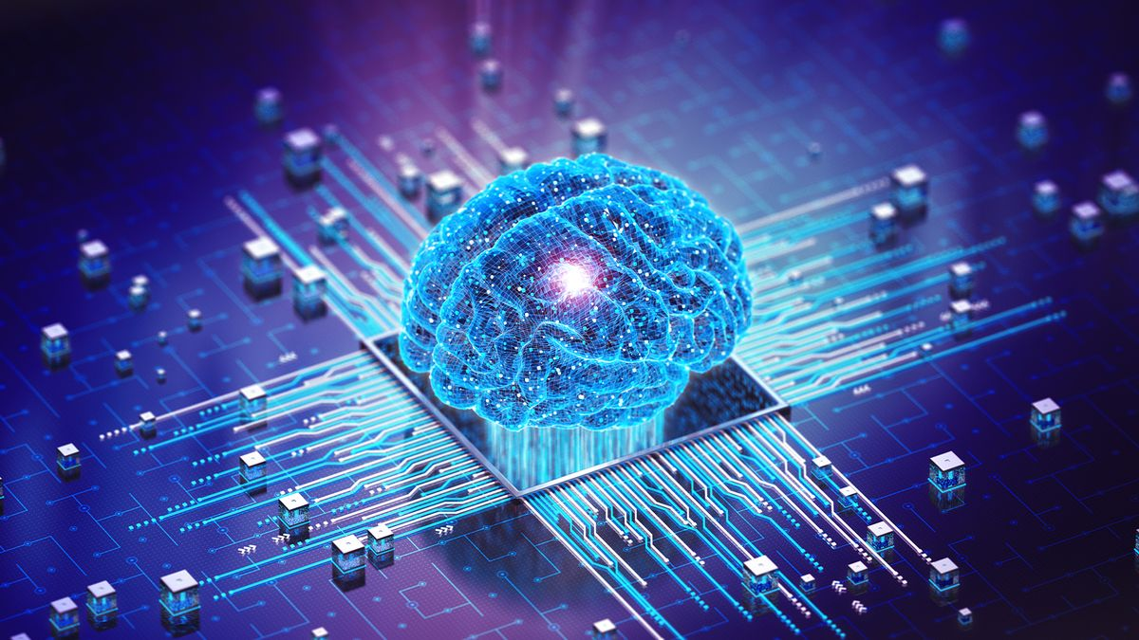
OVERALL INFORMATION AND TOOLS
ADVANTAGES AND FUTURE USAGE
DISADVANTAGES AND POSSIBLE THREATS

Slide 2
OVERALL INFORMATION AND TOOLS
ADVANTAGES AND FUTURE USAGE
DISADVANTAGES AND POSSIBLE THREATS
OVERALL INFORMATION AND TOOLS
INTELLIGENCE DISPLAYED BY MACHINE – COMPUTER SYSTEMSS
WEB SEARCH ENGINES RECOMMENDATION SYSTEMS HUMAN SPEECH INTERACTION GENERATIVE AND CREATIVE TOOLS

Slide 3
OVERALL INFORMATION AND TOOLS
ADVANTAGES AND FUTURE USAGE
DISADVANTAGES AND POSSIBLE THREATS
OVERALL INFORMATION AND TOOLS
INTELLIGENCE DISPLAYED BY MACHINE – COMPUTER SYSTEMSS
WEB SEARCH ENGINES RECOMMENDATION SYSTEMS HUMAN SPEECH INTERACTION GENERATIVE AND CREATIVE TOOLS
ADVANTAGES AND FUTURE USAGE
REDUCTION OF HUMAN ERROR DECISION MAKING ZERO RISKS 24/7 AVAILABILITY
HEALTHCARE EDUCATION TRANSPORTATION ENVIRONMENT

Slide 4
OVERALL INFORMATION AND TOOLS
ADVANTAGES AND FUTURE USAGE
DISADVANTAGES AND POSSIBLE THREATS
OVERALL INFORMATION AND TOOLS
INTELLIGENCE DISPLAYED BY MACHINE – COMPUTER SYSTEMSS
WEB SEARCH ENGINES RECOMMENDATION SYSTEMS HUMAN SPEECH INTERACTION GENERATIVE AND CREATIVE TOOLS
ADVANTAGES AND FUTURE USAGE
REDUCTION OF HUMAN ERROR DECISION MAKING ZERO RISKS 24/7 AVAILABILITY
HEALTHCARE EDUCATION TRANSPORTATION ENVIRONMENT
DISADVANTAGES AND THREATS
LACKING CREATIVITY AND EMOTIONS HUMAN LAZINESS COSTLY DEVELOPMENT UNEMPLOYMENT
SOCIAL MANIPULATION AUTONOMOUS WEAPONS SELF-AWARE AI CRIMINAL ACTIVITY INCREASE

Slide 5
OVERALL INFORMATION AND TOOLS
ADVANTAGES AND FUTURE USAGE
DISADVANTAGES AND POSSIBLE THREATS
ADVANTAGES AND FUTURE USAGE
REDUCTION OF HUMAN ERROR DECISION MAKING ZERO RISKS 24/7 AVAILABILITY
HEALTHCARE EDUCATION TRANSPORTATION ENVIRONMENT
OVERALL INFORMATION AND TOOLS
WHAT IS AI?
AI TOOLS
DISADVANTAGES AND THREATS
LACKING CREATIVITY AND EMOTIONS HUMAN LAZINESS COSTLY DEVELOPMENT UNEMPLOYMENT
SOCIAL MANIPULATION AUTONOMOUS WEAPONS SELF-AWARE AI CRIMINAL ACTIVITY INCREASE
SUMMARY AND CONCLUSION

Slide 6
OVERALL INFORMATION AND TOOLS
ADVANTAGES AND FUTURE USAGE
DISADVANTAGES AND POSSIBLE THREATS
ADVANTAGES AND FUTURE USAGE
DISADVANTAGES AND THREATS
REDUCTION OF HUMAN ERROR DECISION MAKING ZERO RISKS 24/7 AVAILABILITY
HEALTHCARE EDUCATION TRANSPORTATION ENVIRONMENT
LACKING CREATIVITY AND EMOTIONS HUMAN LAZINESS COSTLY DEVELOPMENT UNEMPLOYMENT
SOCIAL MANIPULATION AUTONOMOUS WEAPONS SELF-AWARE AI CRIMINAL ACTIVITY INCREASE
OVERALL INFORMATION AND TOOLS
WHAT IS AI?
AI TOOLS
SUMMARY AND CONCLUSION
THANK YOU!

Slide 7
OVERALL INFORMATION AND TOOLS
ADVANTAGES AND FUTURE USAGE
DISADVANTAGES AND POSSIBLE THREATS
ADVANTAGES AND FUTURE USAGE
DISADVANTAGES AND THREATS
REDUCTION OF HUMAN ERROR DECISION MAKING ZERO RISKS 24/7 AVAILABILITY
HEALTHCARE EDUCATION TRANSPORTATION ENVIRONMENT
LACKING CREATIVITY AND EMOTIONS HUMAN LAZINESS COSTLY DEVELOPMENT UNEMPLOYMENT
SOCIAL MANIPULATION AUTONOMOUS WEAPONS SELF-AWARE AI CRIMINAL ACTIVITY INCREASE
OVERALL INFORMATION AND TOOLS
SUMMARY AND CONCLUSION
WHAT IS AI?
AI TOOLS
THANK YOU!

